Slide 1
Multi-Agent Reinforcement Learning Simulation
Project Overview and Demonstration
By: Timothy Mugambi (YC8EU4) yc8eu4@inf.elte.hu

Slide 2
Directory Structure
data/: Input datasets and configuration files
logs/: TensorBoard logs and performance metrics
models/: Saved trained models
notebooks/: Jupyter notebooks for exploratory experiments
outputs/: Visualization outputs (e.g., GIFs)
src/: Source code for the project
venv/: Virtual environment containing dependencies
dependencies.txt: List of Python dependencies
README_Tim.md: Comprehensive documentation

Slide 3
Project Dependencies
gymnasium: Toolkit for constructing RL environments
stable-baselines3: Efficient RL algorithms, including PPO
pettingzoo: Multi-Agent RL API
supersuit: Preprocessing for RL environments
shapely: Geometry handling and spatial reasoning
pygame: Simulation rendering
imageio: Simulation GIF generation
pillow: Image rendering and processing

Slide 4
Simulation Environment Details
Agents navigate dynamic environments
Good Agents (blue): Arrest bad agents
Bad Agents (red): Avoid capture
Obstacles: Fixed polygons, mountains
Rewards: Incentivize objectives, penalize undesired actions

Slide 5
Training Process
Algorithm: Proximal Policy Optimization (PPO)
Logging: Metrics tracked in TensorBoard
Rewards: Balancing exploration and exploitation
Early Stopping: Stops training once rewards reach a threshold

Slide 6
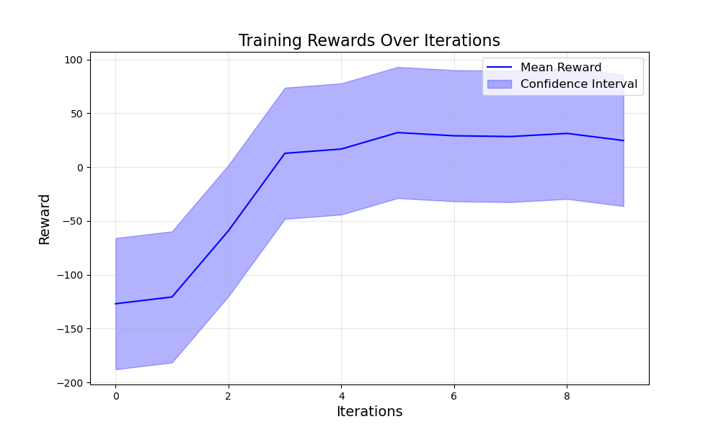
Reward Metrics

Slide 7
Simulation Visualization
GIFs demonstrate:
- Agent strategies
- Dynamic interactions
- Objective success
Visual distinctions:
- Good agents: Blue
- Bad agents: Red

Slide 8
Outputs and Interpretation
Logs: TensorBoard logs stored in `logs/tensorboard`
Models: Trained PPO models saved in `models/`
Simulation: Output GIFs saved in `outputs/simulation.gif`

Slide 9
Challenges and Solutions
Multi-Agent Coordination:
- Solution: Refined reward functions
Complex Environments:
- Solution: Dynamic boundaries
Efficient Logging:
- Solution: Optimized TensorBoard integration

Slide 10
Future Enhancements
Introduce hierarchical agent roles
Add moving obstacles for complexity
Experiment with alternative RL algorithms
Scale simulations to hundreds of agents

